Slide 1
Project: Plastics Data Source: Plastic pollution Category: Agriculture & Climate
Group 1
members:
1.Maureen wachinga Gichuki
2. James mwangi
3. Lucy njeri sopia

Slide 2
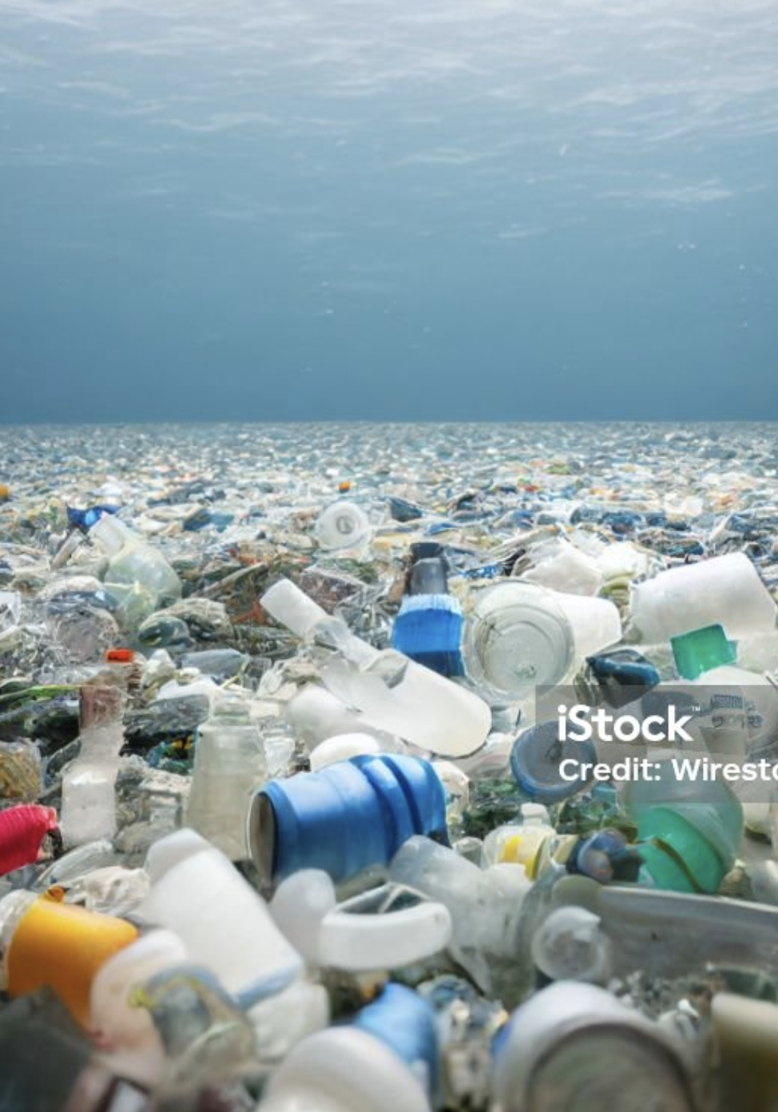
PLASTIC POLLUTION
Plastic pollution is a significant environmental issue resulting from the accumulation of plastic products in the environment.
Sources of pollution.
Plastic pollution mainly comes from single-use plastics, such as bags, bottles, straws, and packaging materials. Industrial activities and improper waste management also contribute.

Slide 3
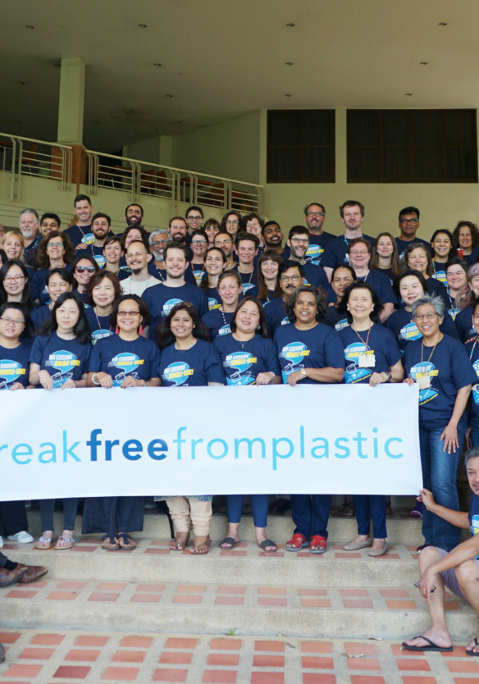
Source of Data
The dataset is from Break Free from Plastic (BFFP) courtesy of Sarah Sauve
About BFFP
#BreakFreeFromPlastic is the global movement working to achieve a future free from plastic pollution. More than 13,000 organizations and individuals around the world have come together to demand reductions in single-use plastics and to advocate for lasting solutions to the plastic pollution crisis. BFFP members work together to bring about systemic change by tackling plastic pollution across the whole value chain - from extraction to disposal - focusing on prevention rather than cure.

Slide 4
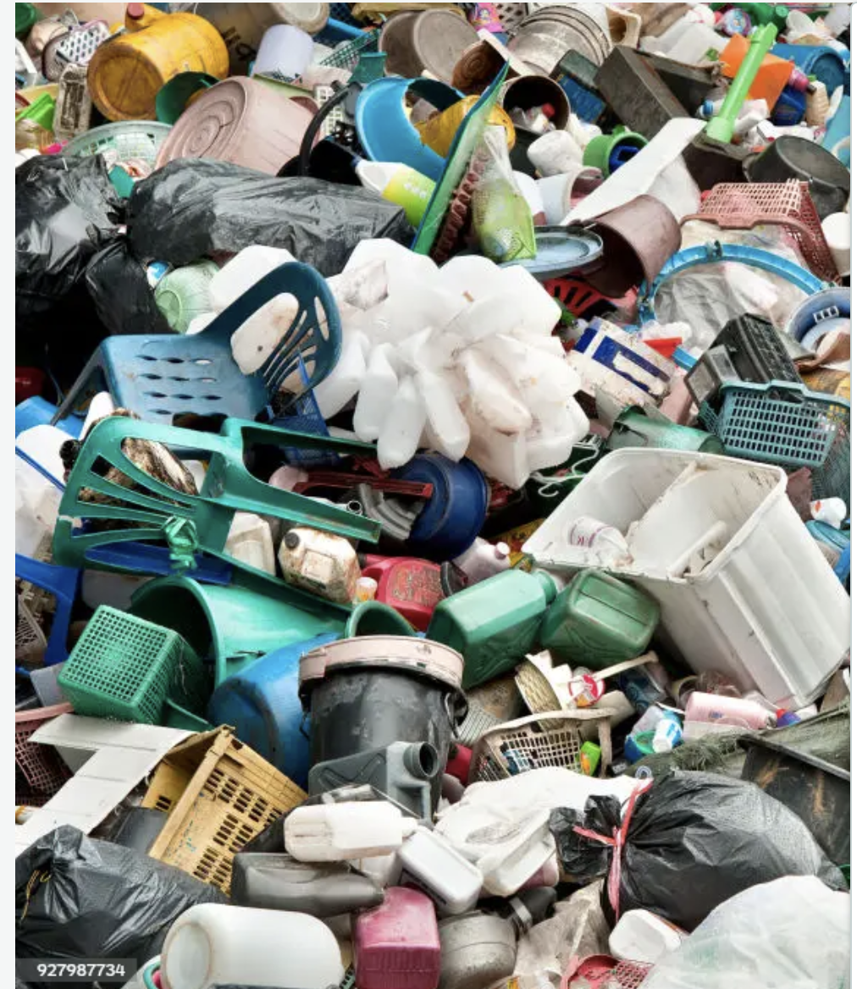
IMPACT OF PLASTIC POLLUTION
Impact on Wildlife:
Animals can ingest plastic or become entangled in it, leading to injury or death. Microplastics can enter the food chain, affecting a wide range of species.
Environmental Effects:
Plastics can take hundreds of years to decompose, leading to long-term environmental damage. They can release toxic substances into the soil and water.
Human Health:
Microplastics have been found in drinking water and food, raising concerns about potential health impacts on humans.

Slide 5
Definition of terms.
hdpe | High density polyethylene : (Plastic milk containers, plastic bags, bottle caps, trash cans, oil cans, plastic lumber, toolboxes, supplement containers)
ldpe | Low density polyethylene: (Plastic bags, Ziploc bags, buckets, squeeze bottles, plastic tubes, chopping boards)
o | Category marked other
pet | Polyester plastic :(Polyester fibers, soft drink bottles, food containers (also see plastic bottles)
pp | Polypropylene :(Flower pots, bumpers, car interior trim, industrial fibers, carry-out beverage cups, microwavable food containers, DVD keep cases)
ps | Polystyrene :(Toys, video cassettes, ashtrays, trunks, beverage/food coolers, beer cups, wine and champagne cups, carry-out food containers, Styrofoam)
pvc | PVC plastic : (Window frames, bottles for chemicals, flooring, plumbing pipes)

Slide 6
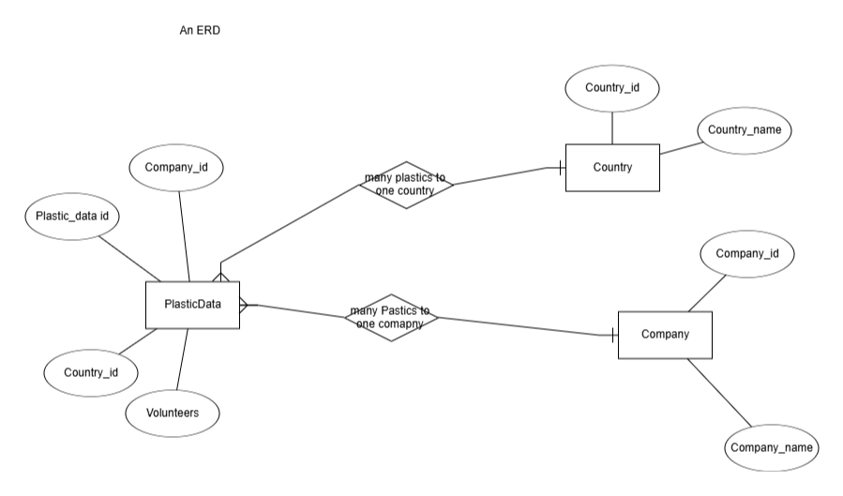
ER Diagram

Slide 7
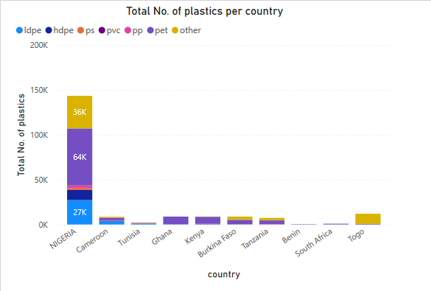
Top Contributing Countries: Nigeria is the largest contributor to plastic waste, with over 144K items, followed by several other countries like Togo, Kenya, and Ghana, each contributing around 9K to 12K items.
Insight: Nigeria's significant lead in plastic waste generation could indicate higher consumption patterns or inefficient waste management. Further analysis could explore policies or industrial practices leading to this result.

Slide 8
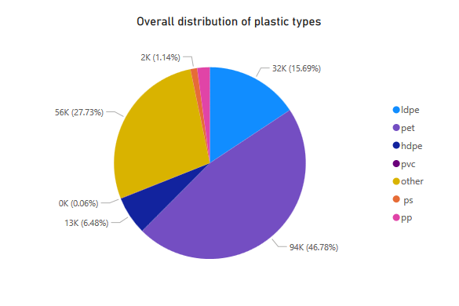
Dominant Plastic Types: PET accounts for 46.78% of total plastics, making it the most significant plastic type. Other prominent types those categorized as ‘other’ at 27.73% and LDPE at 15.69%. Smaller fractions include HDPE, PS, PVC, and PP.
Insight: Since PET is commonly used in beverage containers, this suggests that single-use plastics might dominate in waste generation. The focus could shift toward managing or reducing PET production and disposal.

Slide 9
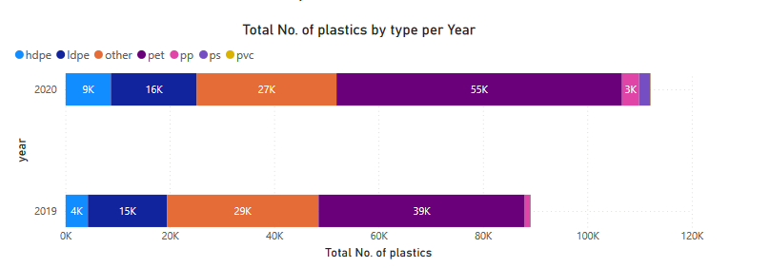
Yearly Progression: The amount of plastic waste has increased from 2019 to 2020, with significant growth in all types. In particular, PET, HDPE, and PP show steady increases over time.
Insight: This could indicate rising consumption or inadequate efforts to curb plastic waste. Analyzing the years further could reveal trends related to specific events or policy changes (e.g., bans on certain plastic types).

Slide 10
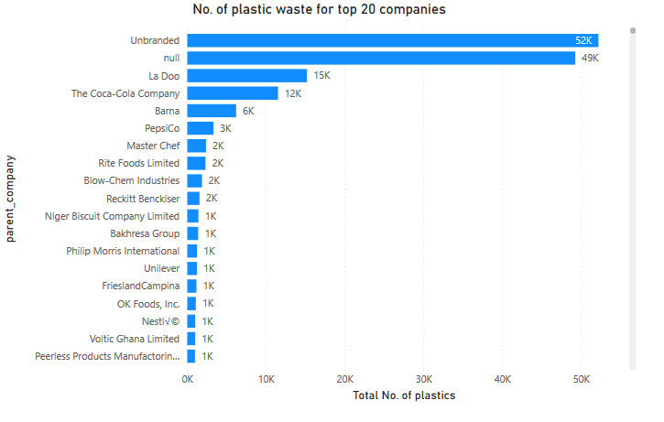
Top Companies: "Unbranded" plastics contribute the highest waste, likely reflecting generic or non-branded products. Leading companies in plastic waste include La Doo, Coca-Cola, Barna and PepsiCo.
Insight: These brands contribute significantly to the plastic problem, particularly with PET and PP plastics. This insight could drive corporate responsibility discussions, focusing on brand accountability and efforts to reduce single-use plastics.

Slide 11
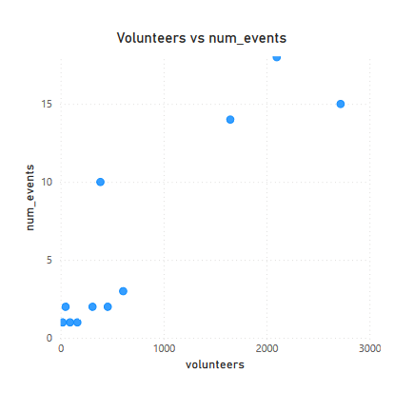
Key Observation: There appears to be a linear relationship between the number of volunteers and events held for plastic collection or management. However, the total plastics collected might not directly correlate with the number of volunteers or events.
Insight: More events or volunteers don't always equate to higher waste collection. It would be valuable to assess the efficiency of these events or look into strategies to maximize the impact of each event.

Slide 12
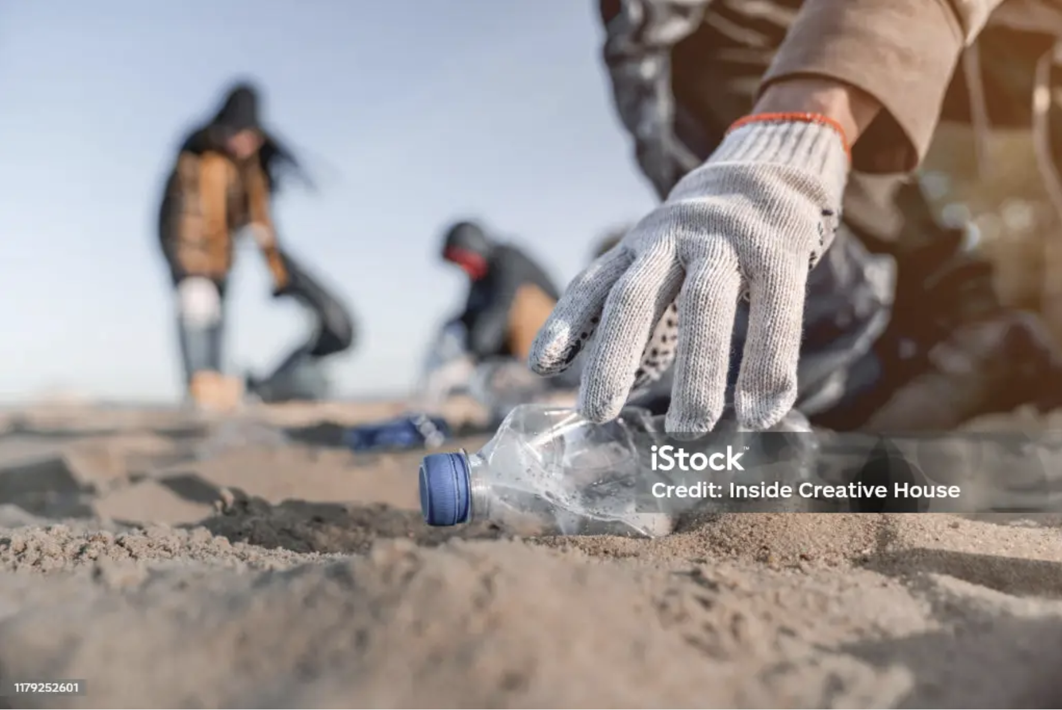
Solutions:
Reducing plastic pollution involves strategies like improving waste management, promoting recycling, banning single-use plastics, and encouraging alternatives such as biodegradable materials.
Awareness and Action:
Public awareness campaigns, community clean-ups, and policy changes can help combat plastic pollution on local and global scales.
Addressing this issue requires collective effort from individuals, communities, businesses, and governments.

Slide 13
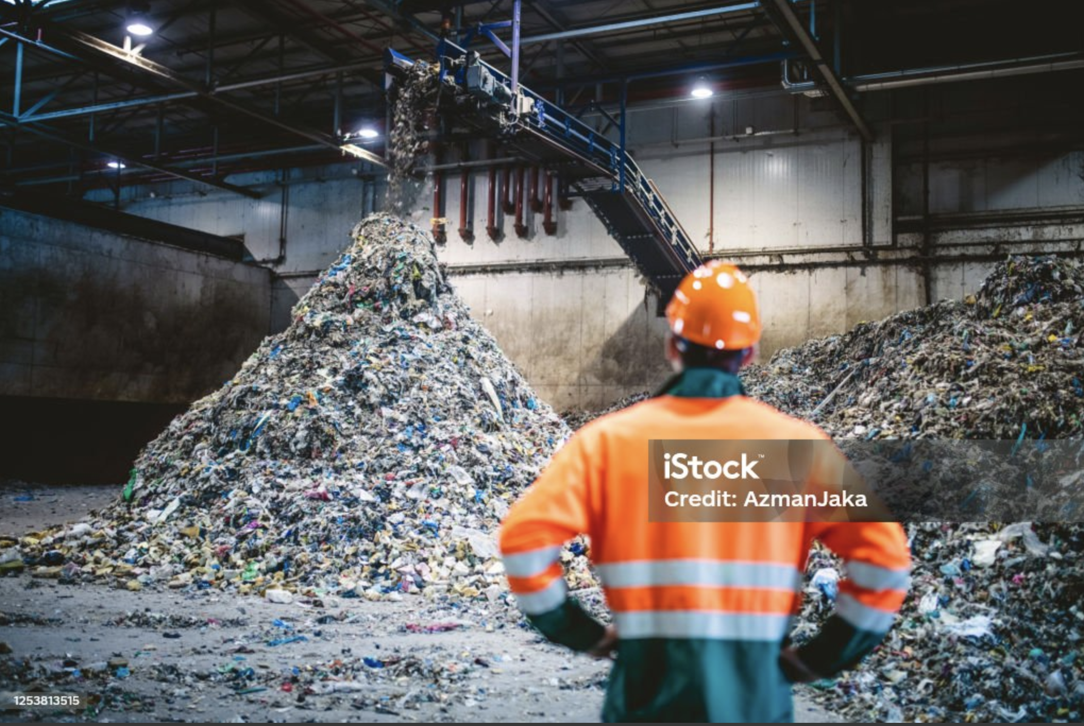
NEXT STEPS
Investigate Missing Data on Smaller Companies:
Unbranded plastics account for the largest share of waste, suggesting a gap in identifying smaller or local brands that contribute significantly to plastic pollution. A deeper investigation into these players could lead to more precise, targeted recommendations for reducing plastic waste.
Evaluate the Effectiveness of Existing Policies:
Assess how recent policies, such as bans on single-use plastics (e.g., plastic bags), have influenced plastic waste generation in different regions. Determine whether these policies have resulted in meaningful reductions and identify areas where enforcement or policy updates could be improved.

